Slide 1
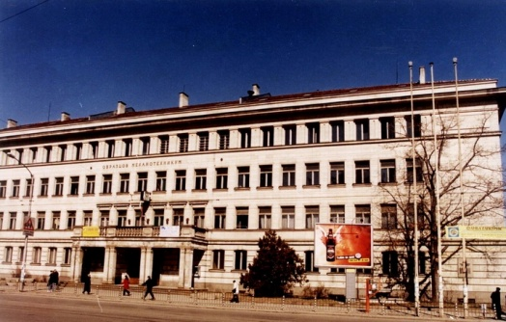
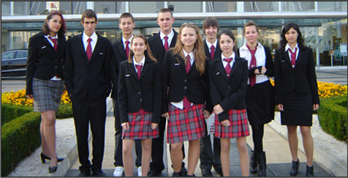
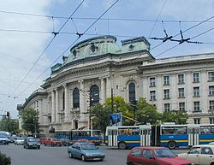
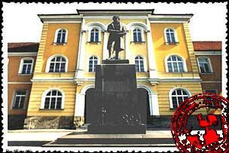
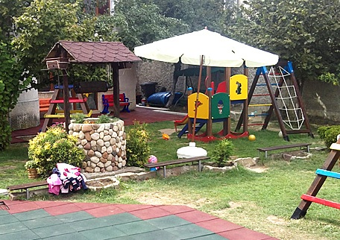
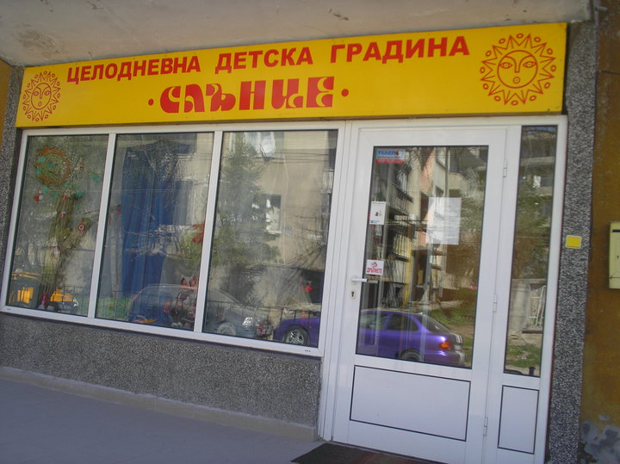
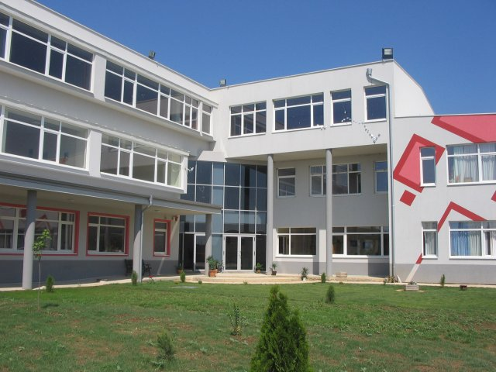
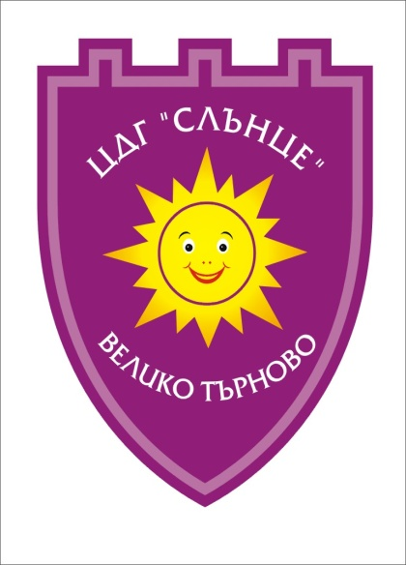
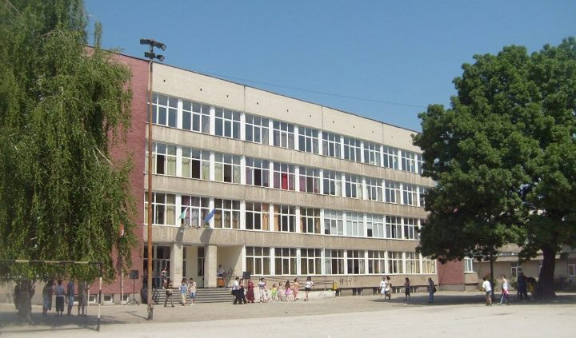
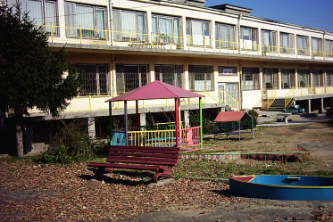
Bulgaria, city: Veliko Tarnovo, Kindergarten “Slance”, November 2019, Project: „By experimenting we are discovering the world around us ”
Bulgarian Education System

Slide 2
Structure
Education in Bulgaria is compulsory until the age of 16.
The school year consists of two terms, starts on September 15th and ends in May or June.
The education system consists of the following levels: pre-primary education,
primary education, secondary education and higher education.
Pre-primary education (ISCED’97, Level 0) embraces the children between 3 to 6/7 years old.
The attendance of kindergarten is optional.
Elementary education (grades 1 to 8 ISCED’97 Level 1, 2 and 2А)
comprises primary school (grades 1 through 4)
and lower secondary school/second step of basic school (grades 5 - 8).
Elementary education can be obtained at state schools,
municipality schools or private schools. In addition,
at the same education level, vocational training is available in accordance
with professional-technical curricula upon completion of grades 6, 7 or 8.
School children who have successfully completed grade 4
obtain the Certificate for Primary Education.
The Certificate for Elementary Education is issued for the successful completion of grade 8.

Slide 3
Education in Bulgaria is opening to the world and the needs of the knowledge
based economy. Most educational institutions have good computer
facilities and broadband Internet connection. Teachers apply interactive
methods in their class work. Teaching of foreign languages is
introduced from an early age in kindergartens and schools.
The Bulgarian universities are opening to foreign students. The academic
programmes are developed in line with European trends - the Bologna
process. The academic staff is being enriched by young specialists educated
abroad. English taught courses are introduced in many universities.
People wishing to study in Bulgaria or to enroll their children should contact
the relevant embassies or consulate office of their country of origin
(Education Office), or the Bulgarian Ministry of Education, Youth and Science
(http://mon.bg) .
More info on Bulgarian education system:
http://eacea.ec.europa.eu/education/eurydice

Slide 4
LEVELS | STAGES |  | AGE Of LEARNERS | TypE Of PROVIDERS
BASIC EDUCATION | Pre-school Education |  | 5-7 | School based in pre-primary groups Kindergarten based
 | Primary Education |  | 6/7 – 9/10 | General schools
 | (General Lower secondary) |  | 10/11 – 14-15 | General schools
Diploma for completed Basic Education
SECONDARY EDUCATION | Upper Secondary education 1st stage Grades 8-10 |  | 14/15 – 18/19 Compulsory education age is 16 | General schools Language schools Sport schools Art schools Vocational gymnasia
 | 2nd stage Grades 11-12
Certificate for completed 1st stage of Secondary Education after 10th grade. Diploma for completed secondary education after second stage (12 grade) and possibility for continuing education in Colleges and Universities
UppER SECONDARy NON-TERTIARY | College Education | After completed Secondary Education 19-22 |  |  | Vocational colleges Art colleges Medical Colleges
Diploma for completed education as Specialist

Slide 5
LEVELS | STAGES | AGE Of LEARNERS |  | TypE Of PROVIDERS
HIGHER EDUCATION | Bachelor Doctor | After completed Secondary or |  | Humanitarian Universities Technical Universities Art Universities Sport Universities Medical Universities
 | Master | College Education After completed
 | Doctor | After completed Master degree
Diploma for completed education as Specialist
CONTINUING TRAINING | NON-FORMAL |  | INFORMAL
CVET in VET Centers for up-grade or acquisition of vocational qualification Continuing training in University’s Departments for additional qualification | Non-formal learning for key competencies, languages, art, sport, out of class activities |  | Informal learning: in the family, at the workplace, through media, libraries, etc.

Slide 6
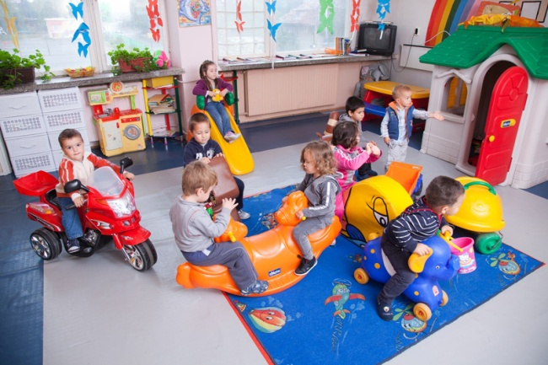
Pre-school education
Pre-school education (ISCED’97, Level 0) embraces the children between 3 to 6/7 years. The attendance of kindergarten is optional. Next to the state-run kindergartens, which prevail (over 95 %), there are also private ones and their number is growing.

Slide 7
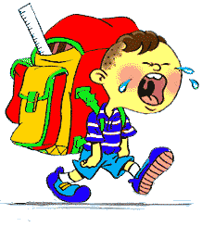
Elementary and secondary education
Elementary education (grades 1 through 8) comprises primary school (grades 1 through 4 ISCED’97 Level 1) and junior high school (grades 5 – 8, ISCED’97 Level 2A). Elementary education can be obtained at state, municipality or private schools. In addition, at the same education level, vocational training is available in accordance with professional-technical curricula upon completion of grades 6, 7 or 8. The Certificate for Primary Education is issued upon successful completion of grade 4 and the Certificate for Elementary Education is obtained for successful completion of grade 8.
Secondary education (ISCED’97 Level 3А) can be divided into comprehensive education (comprehensive and specialized schools) and vocational training. General secondary education can be obtained at comprehensive schools (course duration 3-4 years) and at specialized schools (course duration 4-5 years). The admission in the specialized schools is upon completion of grades 7 or 8 and after exams depending on the profile of the school. (in Bulgarian language and literature, mathematics, humanities etc.)
Secondary education can be obtained also at technical schools after completion of grade 8 and 4 years of training or after completion of grade 7 and 5 years of training. Vocational schools with a three-year curriculum also provide secondary education.
Educational curricula for technical vocational schools (ISCED’ 97 Level 3С) are offered after completion of elementary education, the course duration is 2 years. The acquired vocational qualification enables the access to the labor market.

Slide 8
General secondary (comprehensive) education
The general secondary education (upper level) can be divided into secondary comprehensive and secondary specialized education. Secondary comprehensive education can be obtained at secondary comprehensive schools (for 3-4 years), and the secondary specialized education – at specialized secondary schools (for 4-5 years). The admission to the specialized schools is upon completion of grade 7 or grade 8 and successful passage of the entry exams, corresponding to the school profile (in Bulgarian language and literature, mathematics, humanities etc.)
General secondary education (upper level) is offered by:
Secondary comprehensive schools, they cover: primary school level – grades 1 through 4; junior high school – grades 5 through 8 and secondary school level – grades 9 through 11.
Specialized schools with emphasis on foreign languages (language schools) – admission after grade 7 and upon entry exams. They cover grades 8 through 12/13.
Specialized secondary schools – admission upon completion of grade 8 (theses are schools with emphasis either on science and/or mathematics, or on humanities, or sports, or arts etc.) They cover grades 9 through 12/13.

Slide 9
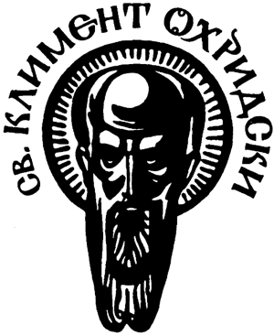
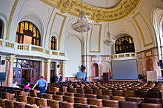
SOFIA UNIVERSITYST. KLIMENT OHRIDSKI
1504 Sofia, 15 Tsar Osvoboditel Blvd.
Phone Еxchange: (+359 2) 9308 200 begin_of_the_skype_highlighting (+359 2) 9308 200 end_of_the_skype_highlighting Fax: (+359 2) 9460 255
The Sofia University St. Kliment Ohridski is the first higher educational institution in Bulgaria. Its history is an embodiment and a continuation of centuries of cultural and educational tradition in this country. Public teaching activities in Bulgaria date back to the second half of the 9th century. During the Bulgarian Renaissance, a new idea for opening a School of Higher Education was conceived.
The prestige of the School of Higher Education grew rapidly with the cultural and educational mission it acquired after the Liberation in 1878.
Year by year the Sofia University has developed into an important academic and scientific centre on the Balkans, a well developed academic institution with European dimensions. Today Sofia University St. Kliment Ohridski is the largest and most prestigious educational and scientific centre in the country. Its main building is situated at 15 Tsar Osvoboditel Blvd. The Faculties of Mathematics and Informatics, Physics, Chemistry, Biology, Journalism and Mass Communication, Theology, Economics and Business Administration, and Preschool and Primary School Education are spread over several campuses around Sofia.
St. Clement of Ohrid University of Sofia
Established1 October 1888 (127 years ago)
Type Public
Rector Professor Ivan Ilchev
Students~21,000
Location Sofia, Bulgaria
Campus Urban
Affiliations EUA
Website www.uni-sofia.bg

Slide 10
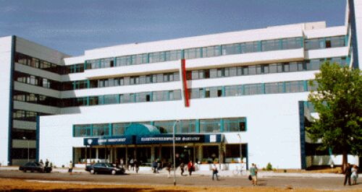
Technical University - Sofia
New Bulgarian University was established on September 18, 1991 by decision of the Grand National Assembly. On July 5, 2001 NBU received institutional accreditation from the National Agency for Assessment and Accreditation for a maximum 5-year period, and in December 2006 received institutional accreditation for a maximum period. Since 2004, the NBU has been approved by The Open University in the UK, as an appropriate organisation to offer higher education programmes leading to Open University Validated Awards. The University in Bulgaria introduces first credit system, the teaching of professional degrees, bachelor's and master's degree, distance and continuing education. Personalities of world renown are honorary professors and honorary doctors of the NBU, including - Richard Rorty, Vera Mutafchieva, Julia Kristeva, Jean-Pierre Vernant , Milcho Leviev, Robert Young, Raina Kabaivanska, Lord Ralf Dahrendorf, Terry Eagleton and others.
More than 66 years University prepares specialists in the field of engineering. During this period, more than 100,000 engineers graduated from it and have found career not only at home but also abroad. The structure of TU - Sofia has 14 faculties, several departments, a college and other units in which students are taught and carried out research. The University has a branch in Plovdiv with two faculties and one college, based in Sliven, which consists of one faculty and one college.

Slide 11
Bulgarian Universities alphabetically
American University in Bulgaria
European Polytechnical University
New Bulgarian University
Varna Free University
Burgas Free University
Higher School of Insurance and Finance
National Academy for Theatre and Film Arts
"Pantcho Vladigerov" National Academy of Music
National Academy of Arts
National Sports Academy
Medical University - Sofia
Medical University - Varna
Medical University - Plovdiv
Medical University - Pleven
Trakia University - Stara Zagora
Rakovski Defence and Staff College
National Military University
"Nikola Vaptsarov" Naval Academy
"Lyuben Karavelov" Civil engineering university
"Todor Kableshkov" Higher School of Transport
Specialized Higher School of Librarian Knowledge and Information Technology - Sofia
Sofia University
Plovdiv University
Veliko Tarnovo University
South-West University "Neofit Rilski“
University of Shumen "Episkop Konstantin Preslavski“
Technical University of Sofia
Technical University of Sofia - Branch Plovdiv
Technical University of Varna
Technical University of Gabrovo
Ruse University
University of Architecture, Civil Engineering and Geodesy
University of Mining and Geology
University of Chemical Technology and Metallurgy
University "Prof. Asen Zlatarov" - Burgas
University of Forestry
Agricultural University – Plovdiv
University of Food Technology
University of National and World Economy
University of Economics Varna
Bulgarian Virtual University
D. A. Tsenov Academy of Economics - Svishtov

Slide 12
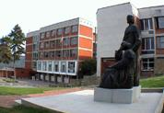
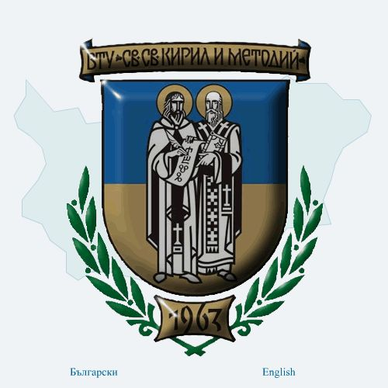
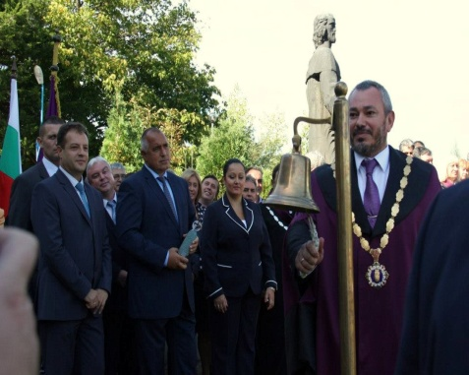
ST. CYRIL AND ST. METHODIUS UNIVERSITY OF VELIKO TURNOVO
The university was founded in 1963, as Brothers Cyril and Methodius Higher Institute of Education and on 14 October 1971 it was established as Bulgaria’s second university under its current name St Cyril and St Methodius University of Veliko Turnovo. The year was deliberately chosen: 600 years earlier, in the fall of 1371, Euthymius, the renowned theologian and writer and later Bulgarian Patriarch, returned from Mount Athos to establish the medieval Turnovo Literary School in the Holy Trinity Monastery near Turnovgrad, an institution whose reputation as a prestigious medieval seat of learning spread the rich repository of Bulgarian literary traditions far beyond the borders of the Second Bulgarian Empire. The Turnovo Literary School had a powerful influence on the development of the literature and literary language in Russia, Serbia, and Romania and also greatly influenced the philosophy and practice of the religious institutions in those countries. For these reasons, despite its relatively short history as a university, Veliko Turnovo University is the rightful heir to centuries-old traditions dating back to the mission of Constantine-Cyril and Methodius among the Slavs.
The university Academic Council strives to respond successfully to the European requirements for accessible higher education and to ensure conditions for lifelong learning. Our aim is to facilitate and promote mobility of students from different countries and universities through the credit accumulation and transfer system and through the implementation of different opportunities for study, training and research. Very much like the most prestigious universities in Europe and the United States, the University of Veliko Turnovo is located in a peaceful and romantic town that pulsates with the university rhythm.
Today St Cyril and St Methodius University of Veliko Turnovo, the largest Bulgarian university outside of Sofia, is a highly-respected centre for fine arts and the humanities, enjoying both a national and international reputation and maintaining a wide range of international contacts around the world.
Solemn opening ceremony of
the academic 2012/2013 year.

Slide 13
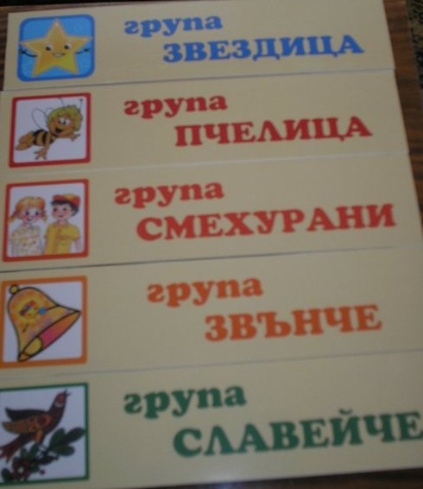
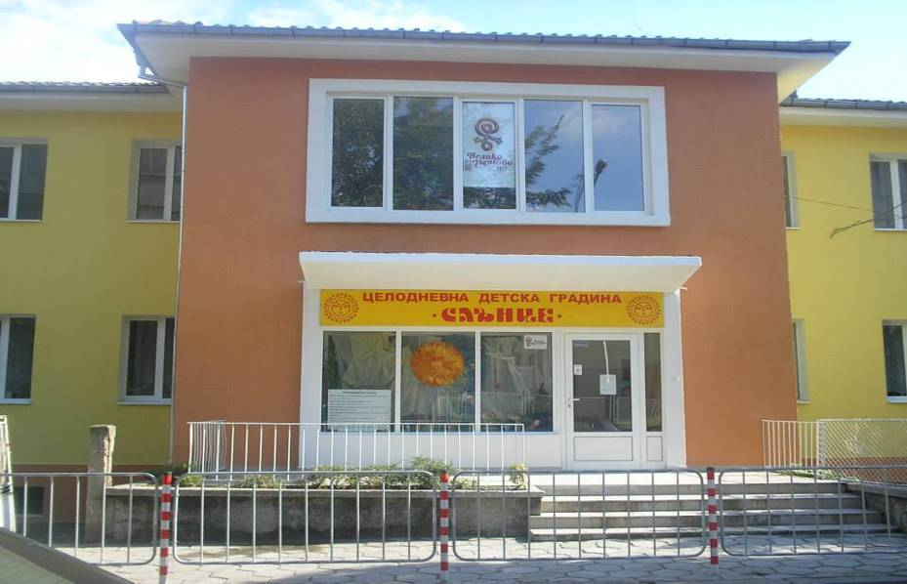
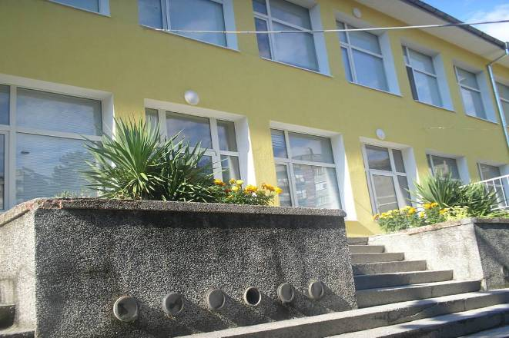
Kindergarten "Slance" is a municipal kindergarten, located near the administrative center of the city.
It is a full-day and one-day organization provides day for children.
Here is the preparation of children for learning, registered office, one year before entering the first grade in the preparatory group formed. The staff work under equal conditions of education, education of children, regardless of their ethnicity, gender, religion, social origin and status. Training and education are secular.
Personnel Kindergarten "Slance" is provided
by highly educated and qualified teachers.
In the educational work with children from 3 to 7 years, educators comply with European
and global trends
in preparing children for school,
respond adequately to the new challenges
in the field of education in the 21st century.
The aim is to achieve the best intellectual, social,
emotional, motivational and psychological development of the child before starting school.
In the academic year 2019-2020
in Kindergarten "Slance" live and educates
165 children,
divided into 5 groups.
Staff - 22, including 21 women and 1 man,
of which 12 are teaching staff
and 10 – not teaching.
From teaching staff
11 are university graduates,
including Director and Music teacher,
6 of them are professional II degree,
and one teacher's college education.
In introduced in 2009 under year system
career development of teachers,
10 of them are "senior teachers"
1 - is "junior teacher". Medical services are provided by nurse.
Non-teaching staff is divided as follows:
1 ZATS, 5 - Assistant educators
1 - cook 1 - assistant chef, ½ laundress
½ kitchen worker and 1-stoker.
Address:
BULGARIA
City: 5000 Veliko Turnovo
Str.: 47 ”Liuben Karavelov “
Tel/fax.+35962 624107
+359882299578
Director: Albena Gencheva
E-mail: albena_g@abv.bg

Slide 14
I write in Cyrillic I am proud to have its own alphabet!

Slide 15
This project is financed with the support of the
European commission.

