Slide 1
NIPIAGOGEIO DREPANOU
ERASMUS+KA229

Slide 2
EXPERIMENTING WITH MOVEMENTS
Learn how to move – Learn to love the movement
Learn their body
learn through movement
Express themselves
Gain better health
Gain life quality
Experiential education relative with their body through play, gym, fairytales, dance

Slide 3
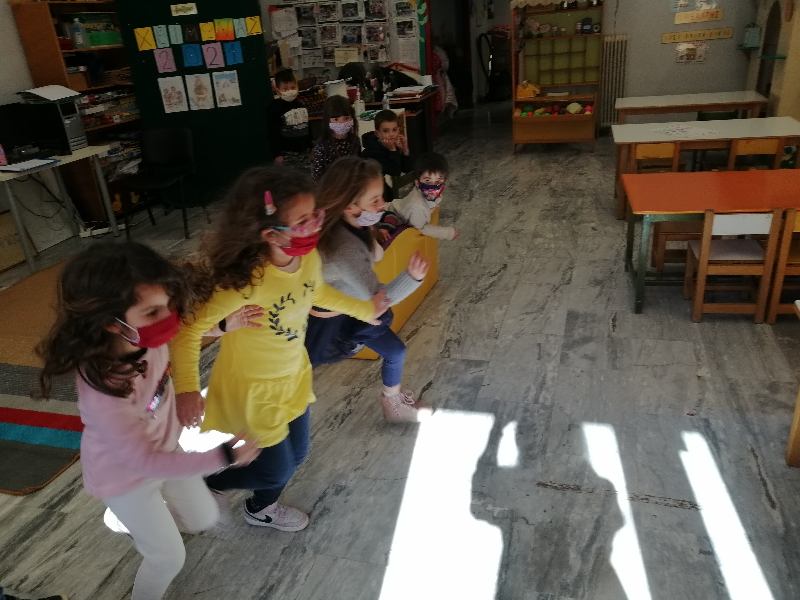
Let’s run ! Who will be the winner? WE DON’T CARE !!!
We run for our health and for fun

Slide 4
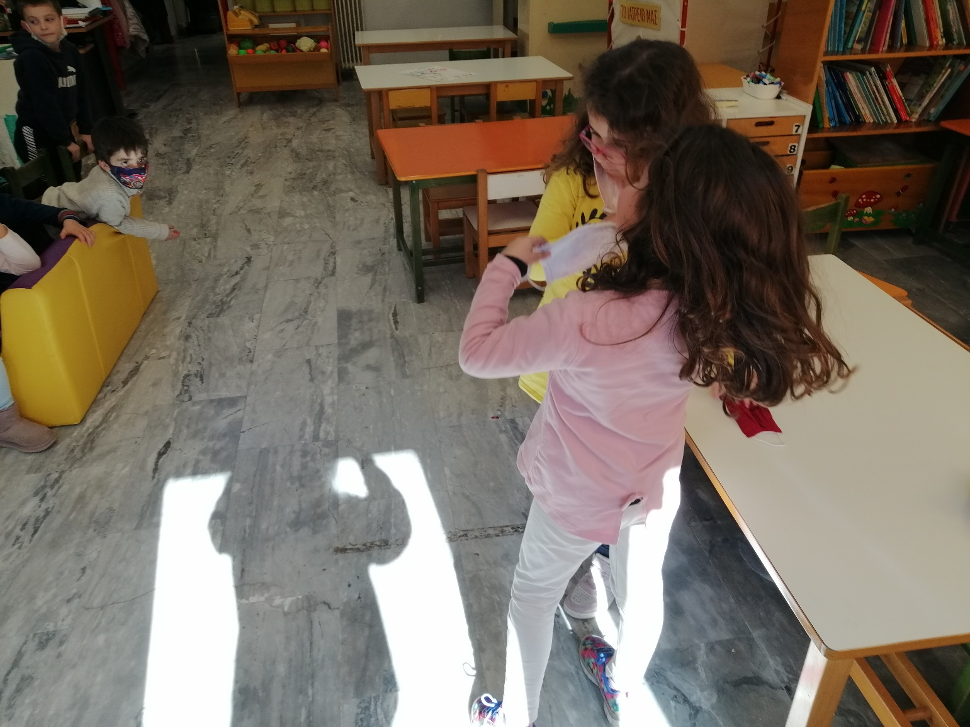
learn our body !
Learn the time learn the space learn how to move
Run front and back
Run in different ways (straight, aslant,
Walk and then run and the opposite

Slide 5
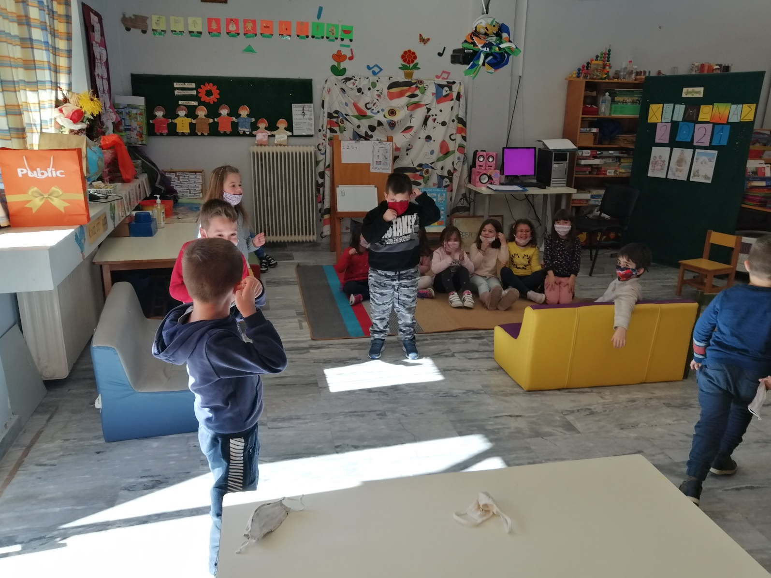
Run front and back
Run in different ways (straight, aslant etc),
Walk and then run and the opposite

Slide 6
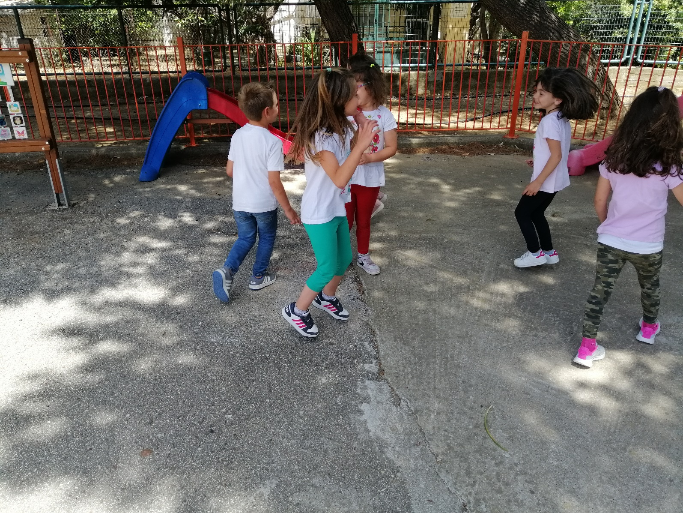
The same activities outdoor
Discussion about the differences
How they feel ?
Which one they prefer ? Why?

Slide 7
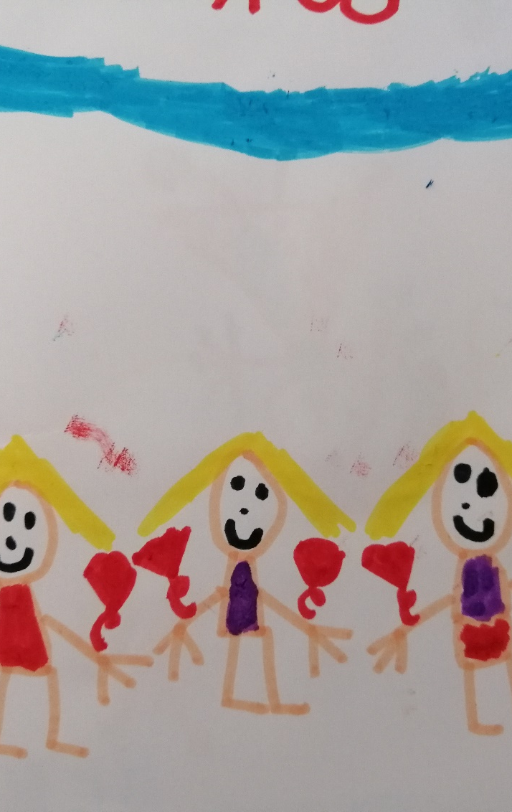

Slide 8
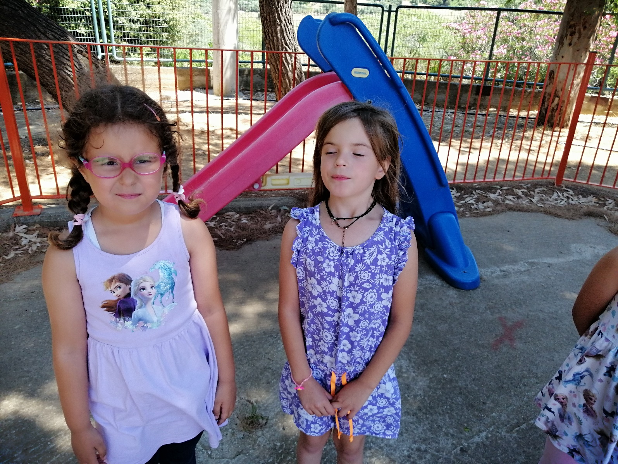
Breathe right and after

Slide 9
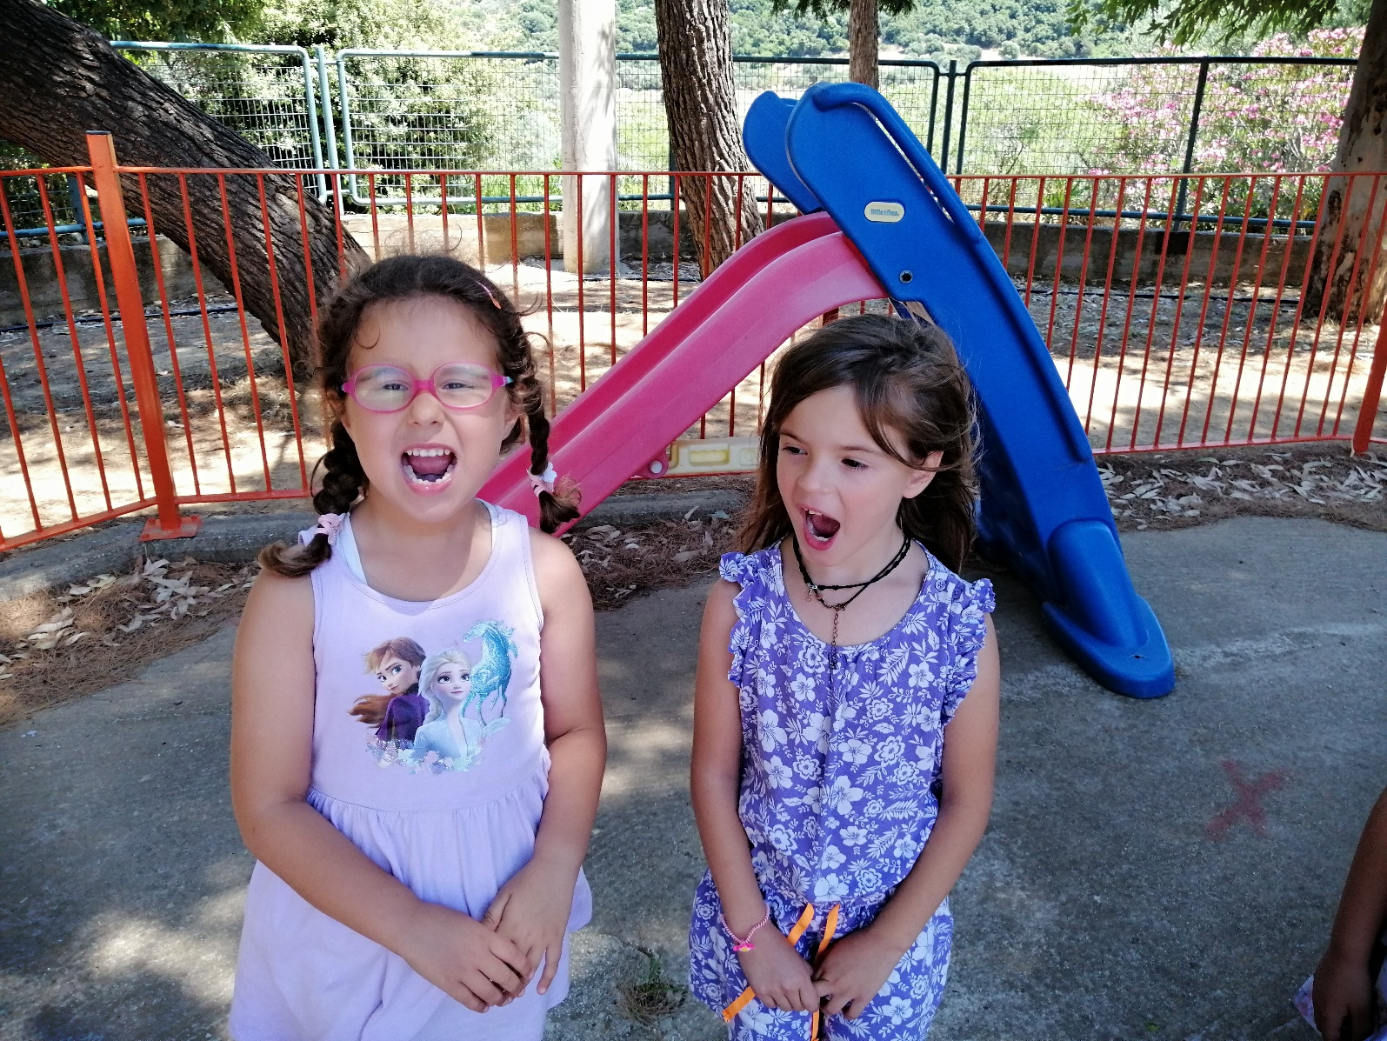
Sing!!!!
Learn how to move their mouth muscles
To do it correctly in order not to scream, got tired etc

Slide 10
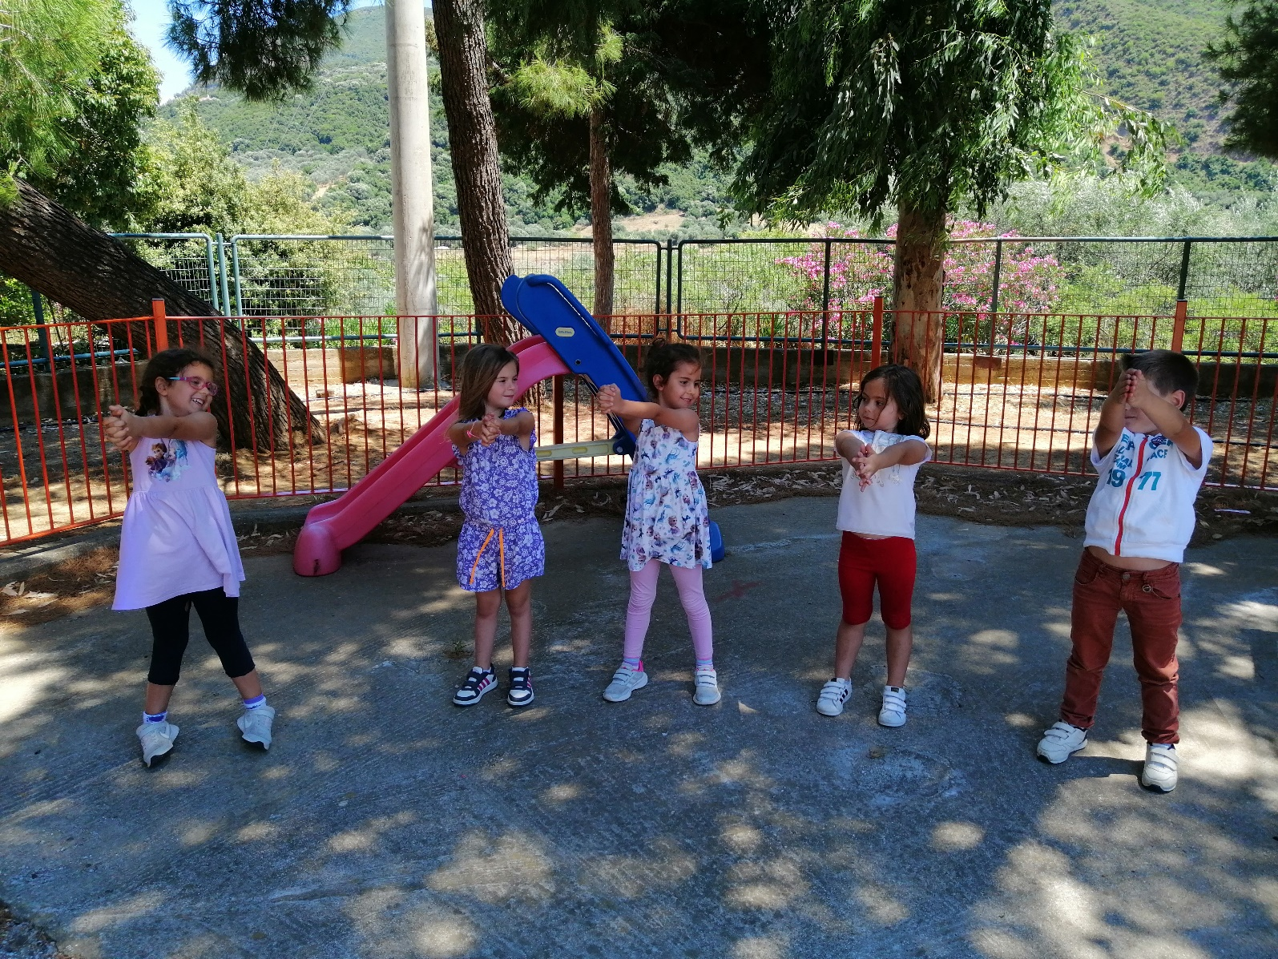
Move their body in the same way

Slide 11
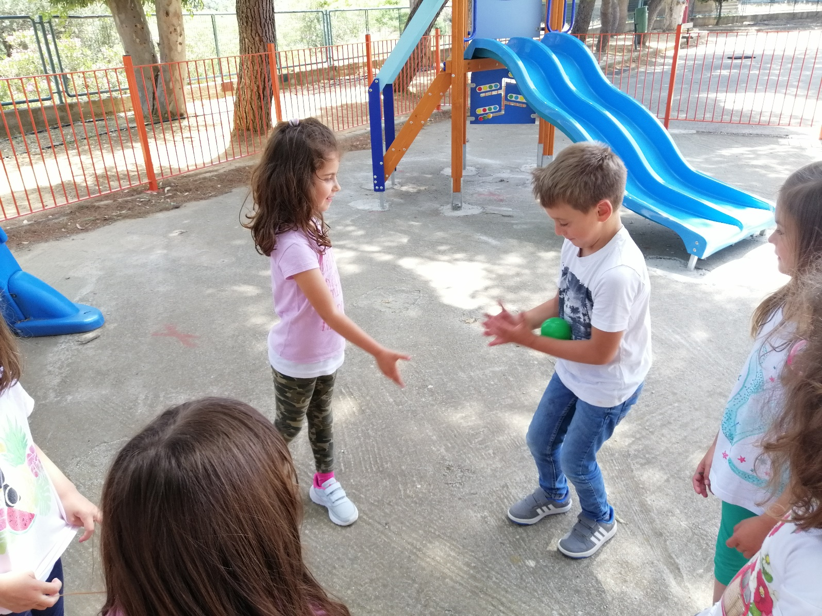
Critical thinking :
Through the ball in a correct way , in a right distance etc

Slide 12
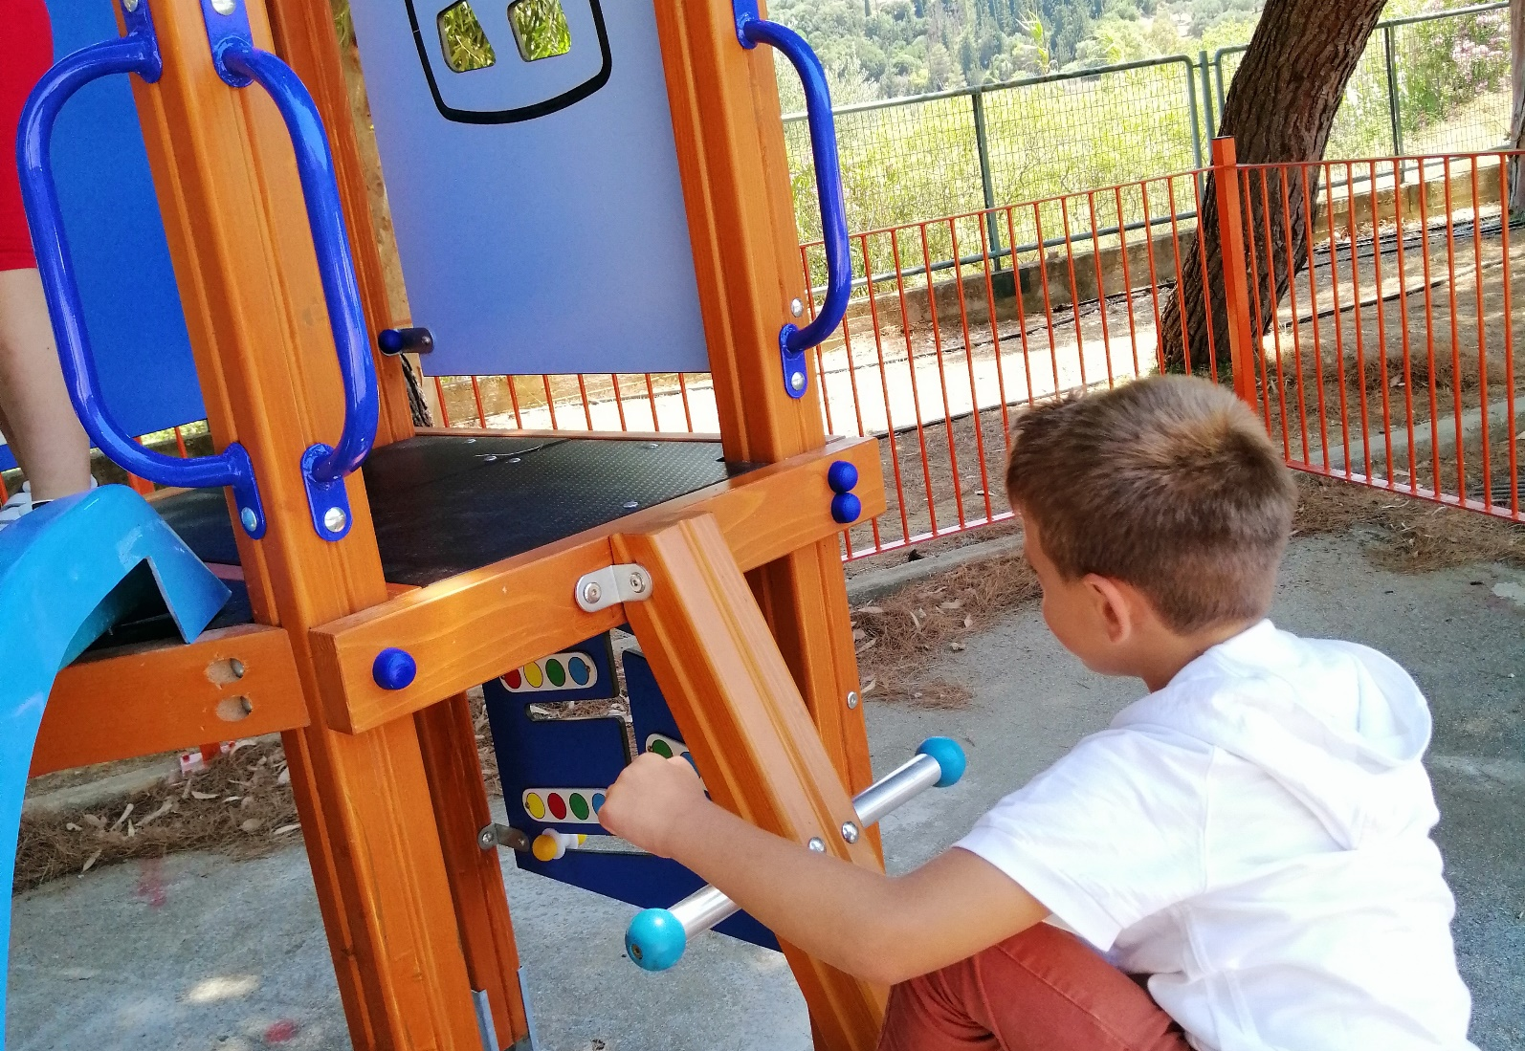
CLIMBING

Slide 13

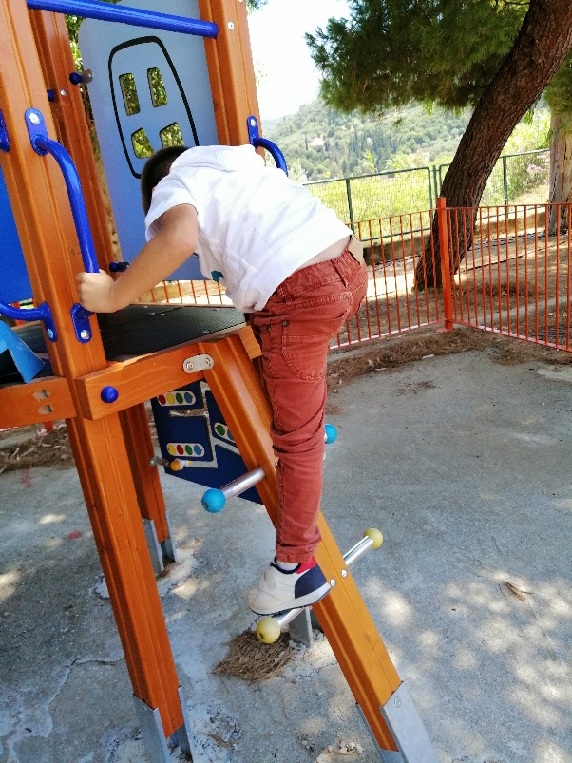
CLIMBING !
Learn how to use the muscles

Slide 14
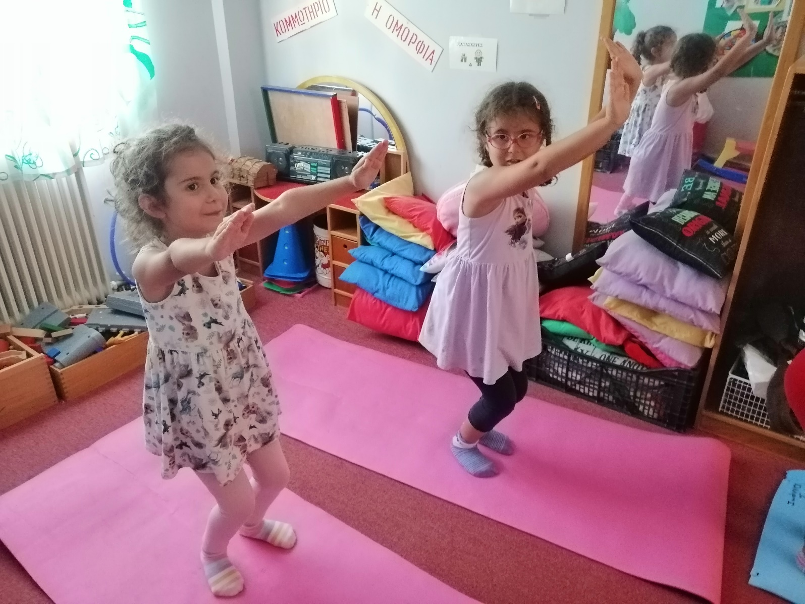
YOGA for
Healthy body and
Healthy mind

Slide 15
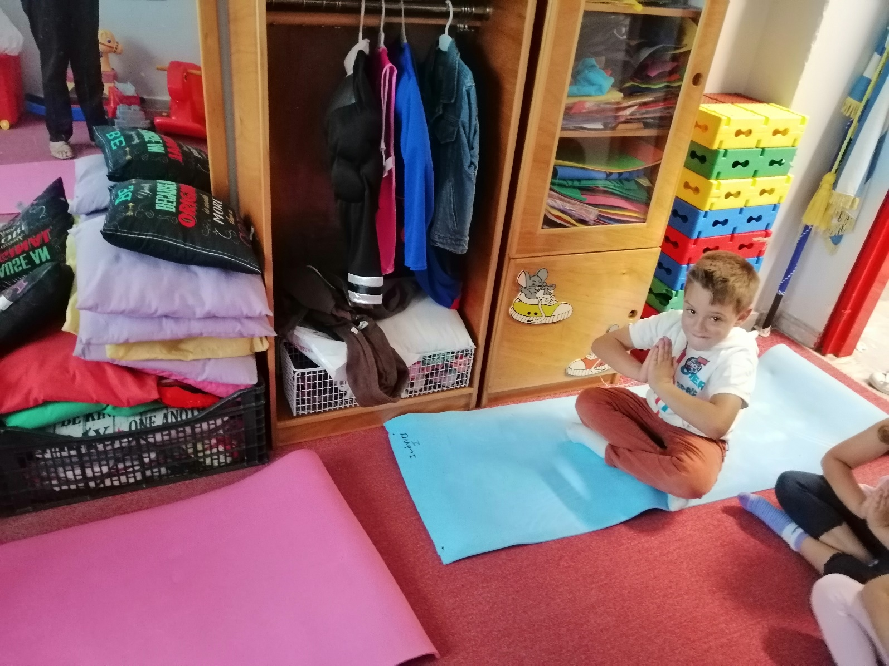
YOGA IS RIGHT FOR EVERYONE !!
BOYS

Slide 16
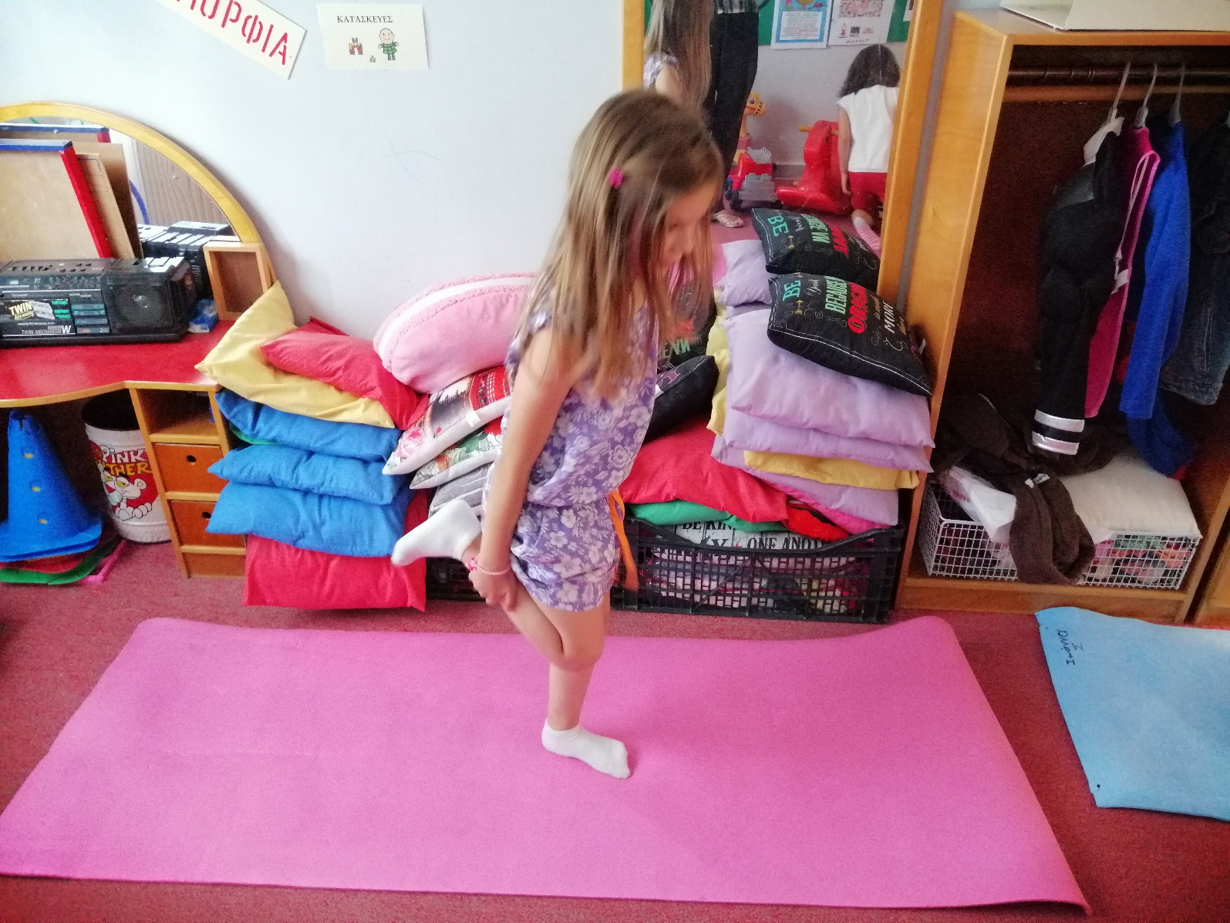
And Girls !

Slide 17
THANK YOU !!
Υπότιτλος

