Slide 1
GREEK ROBOT

Slide 2
NIPIAGOGEIO DREPANOU
Erasmus+
Iky

Slide 3
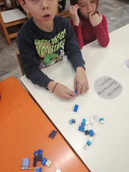
Our robot with Lego blocks
Students create the project robot with Lego blocks

Slide 4
Lego blocks in education

