Slide 1
ROBOTS IN GREEK SCHOOL
ERASMUS+ KA229

Slide 2
Robots came in our school
The 1st robot came from Turkey and student named him Turkey

Slide 3
WELCOME TO OUR SCHOOL

Slide 4
Students create with Lego blocs a place for him
Lego blocs and robot

Slide 5
1.Does Turkey fits? 2. How many Lego bricks have we used?
QUESTIONS AND ANSWERS

Slide 6
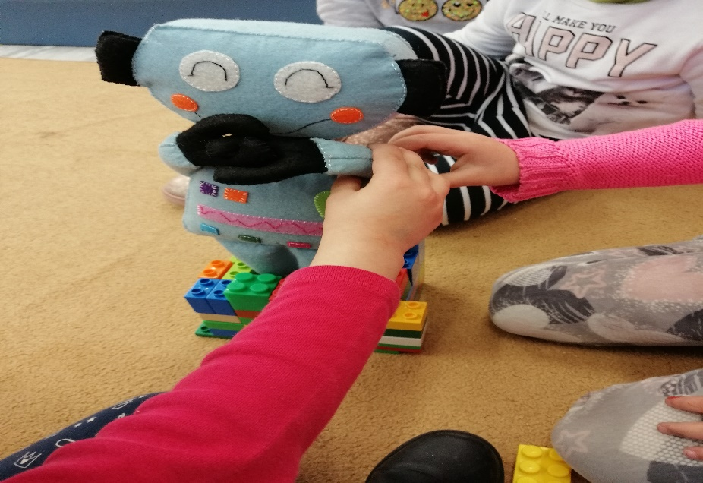
Turkey in the circus !
We count the Lego blocs
Ready!

Slide 7
THANK YOU !

